Slide 1
Design and Analysis of Algorithm
UNIT-III
Dynamic Programming
M Yogi Reddy
Assistant Professor,
Dept. of CSE,
School Of Technology,
GITAM(Deemed to be ) University,
Hyderabad.

Slide 2

Dynamic Programming Applications
Multistage graphs
All pairs shortest paths
Optimal binary search trees
Reliability design
Travelling sales person problem

Slide 3
Optimal Binary Search Tree
Problem
Given a sorted array keys $[0.. n−1]$ of search keys and an array freq $[0.. n−1]$ of frequency counts, where $freq[i]$ is the number of searches to $keys[i]$. Construct a binary search tree of all keys such that the total cost of all the searches is as small as possible.
$$E[\text{search} \text{cost} \text{in} T] \\ =\sum_{i=1}^{n}{(\text{dept}{\text{h}}_{T}(k_{i})⋅p_{i}}$$
𝐸["search cost in " 𝑇] " "=∑_(𝑖=1)^𝑛▒〖("dept" "h" _𝑇 (𝑘_𝑖)⋅𝑝_𝑖 〗
Goal: Build a binary search tree (BST) with minimum expected search cost.

Slide 4
Example1
Input: keys[] = {10, 12}, freq[] = {34, 50}
There can be following two possible BSTs
10 12
\ /
12 10
Tree I Tree II
Frequency of searches of 10 and 12 are 34 and 50 respectively.
The cost of tree I is 34*1 + 50*2 = 134
The cost of tree II is 50*1 + 34*2 = 118
among all possible BSTs, cost of the BST is minimum.
Cost of the 2nd BST is optimal.

Slide 5
Example2
Input: keys[] = {10, 12, 20}, freq[] = {34, 8, 50}
There can be following possible BSTs
10 12 20 10 20
\ / \ / \ /
12 10 20 12 20 10
\ / / \
20 10 12 12
I II III IV V
Among all possible BSTs, cost of the fifth BST is minimum.
Cost of the 5th BST is 1*50 + 2*34 + 3*8 = 142

Slide 6
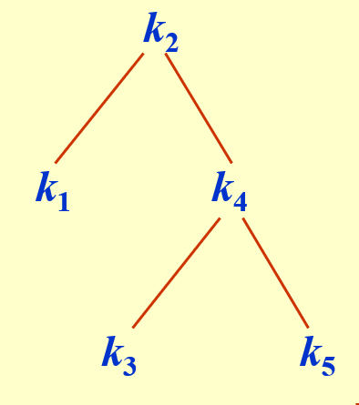

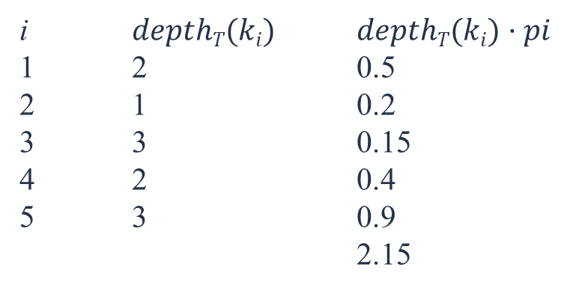
Example of search cost
Consider 5 keys with these search probabilities: $p1 = 0.25, p2 = 0.2, p3 = 0.05, p4 = 0.2, p5 = 0.3.$
i $depthT(ki)$ $depthT(ki)·pi$
1 2 0.5
2 1 0.2
3 3 0.15
4 2 0.4
5 3 0.9
2.15

Slide 7
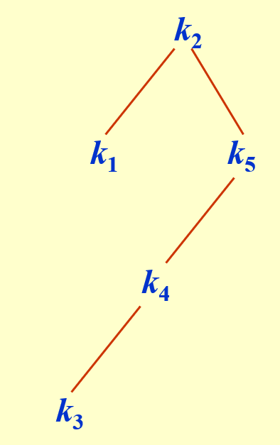
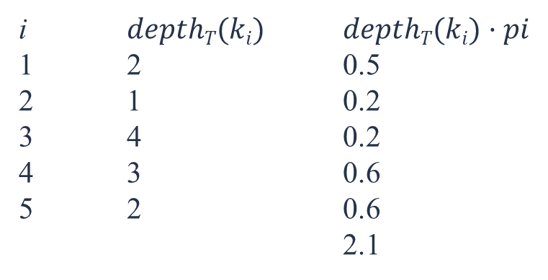
Example of search cost
Consider 5 keys with these search probabilities: $p1 = 0.25, p2 = 0.2, p3 = 0.05, p4 = 0.2, p5 = 0.3.$
i $depthT(ki)$ $depthT(ki)·pi$
1 2 0.5
2 1 0.2
3 4 0.2
4 3 0.6
5 2 0.6
2.1

Slide 8
Observation
Optimal BST may not have smallest height.
Optimal BST may not have highest-probability key at root.
Optimal Substructure
If T is an optimal BST and
T contains subtree $T$with keys $ki, …, kj ,$
T contains subtree 𝑇′ with keys 𝑘_{𝑖}, …, 𝑘_{𝑗} ,
T
T′
then T′ must be an optimal BST for keys $ki, …, kj$.

Slide 9
Example
Construct an optimal binary search tree over five key values k1 < k2 < k3 < k4 < k5 with access probability $0.3, 0.2, 0.1, 0.15, and 0.25,$ respectively.
Start by considering the length of elements in tree from 1 to total number of elements in the tree
 | j=1 | 2 | 3 | 4 | 5
i=1
2
3
4
5
0.3
Assume that we are having tree of length 1 then
0.2
0.1
0.15
0.25

Slide 10
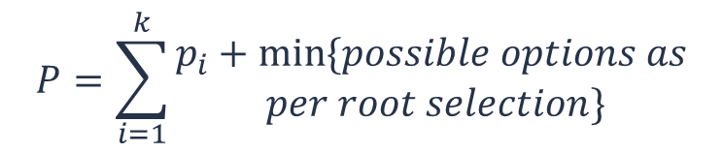

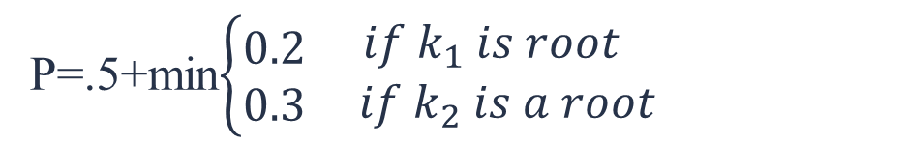
Example
Construct an optimal binary search tree over five key values k1 < k2 < k3 < k4 < k5 with access probability $0.3, 0.2, 0.1, 0.15, and 0.25,$ respectively.
 | j=1 | 2 | 3 | 4 | 5
i=1
2
3
4
5
0.3
$${0.7}^{k_{1}}$$
Assume that we are having tree of length 2 then
0.2
0.1
0.15
0.25
$$P=\sum_{i=1}^{k}{\begin{aligned}p_{i}+min⁡\{possible options as \\ per root selection\}\end{aligned}}$$
k1 < k2 < k3 < k4 < k5
k1 < k2
P=.5+min$\left\{\begin{matrix}0.2 \\ 0.3\end{matrix}\begin{matrix} if k_{1} is root \\ if k_{2} is a root\end{matrix}\right.$

Slide 11



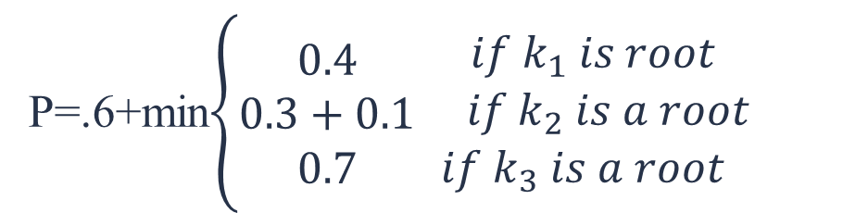

Example
Construct an optimal binary search tree over five key values k1 < k2 < k3 < k4 < k5 with access probability $0.3, 0.2, 0.1, 0.15, and 0.25,$ respectively.
 | j=1 | 2 | 3 | 4 | 5
i=1
2
3
4
5
0.3
$${0.7}^{k_{1}}$$
$${1.0}^{k_{1}}$$
Assume that we are having tree of length 3 then
0.2
$${0.4}^{k_{2}}$$
0.1
$${0.35}^{k_{4}}$$
0.15
$${0.55}^{k_{5}}$$
0.25
$$P=\sum_{i=1}^{k}{\begin{aligned}p_{i}+min⁡\{possible options as \\ per root selection\}\end{aligned}}$$
k1 < k2 < k3 < k4 < k5
k1 < k2 < k3
P=.6+min$\left\{\begin{matrix}0.4 \\ 0.3+0.1 \\ 0.7\end{matrix}\begin{matrix} if k_{1} is root \\ if k_{2} is a root \\ if k_{3} is a root\end{matrix}\right.$

Slide 12

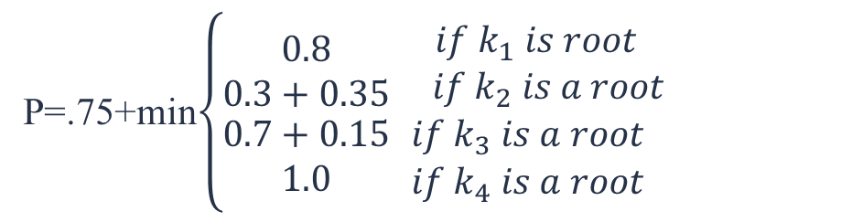
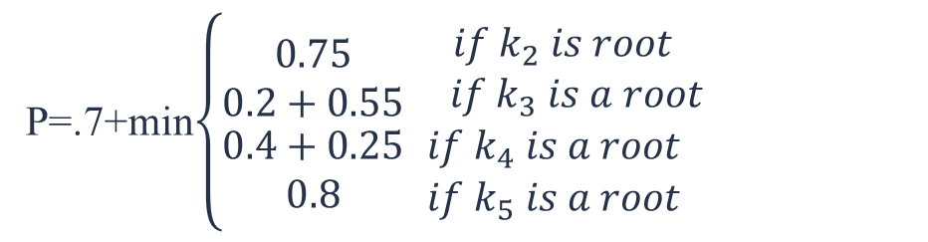



Example
Construct an optimal binary search tree over five key values k1 < k2 < k3 < k4 < k5 with access probability $0.3, 0.2, 0.1, 0.15, and 0.25,$ respectively.
 | j=1 | 2 | 3 | 4 | 5
i=1
2
3
4
5
0.3
$${0.7}^{k_{1}}$$
$${1.0}^{k_{1}}$$
$${1.4}^{k_{2}}$$
Assume that we are having tree of length 4 then
0.2
$${0.4}^{k_{2}}$$
$${0.8}^{k_{2}}$$
$${1.35}^{k_{4}}$$
0.1
$${0.35}^{k_{4}}$$
$${0.85}^{k_{5}}$$
0.15
$${0.55}^{k_{5}}$$
0.25
k1 < k2 < k3 < k4 < k5
k1 < k2 < k3 < k4
k1 < k2 < k3 < k4 < k5
k1 < k2 < k3 < k4 < k5
P=.75+min$\left\{\begin{matrix}0.8 \\ 0.3+0.35 \\ \begin{aligned}0.7+0.15 \\ 1.0\end{aligned}\end{matrix}\begin{matrix} if k_{1} is root \\ if k_{2} is a root \\ \begin{aligned}if k_{3} is a root \\ if k_{4} is a root\end{aligned}\end{matrix}\right.$
P=.7+min$\left\{\begin{matrix}0.75 \\ 0.2+0.55 \\ \begin{aligned}0.4+0.25 \\ 0.8\end{aligned}\end{matrix}\begin{matrix} if k_{2} is root \\ if k_{3} is a root \\ \begin{aligned}if k_{4} is a root \\ if k_{5} is a root\end{aligned}\end{matrix}\right.$

Slide 13

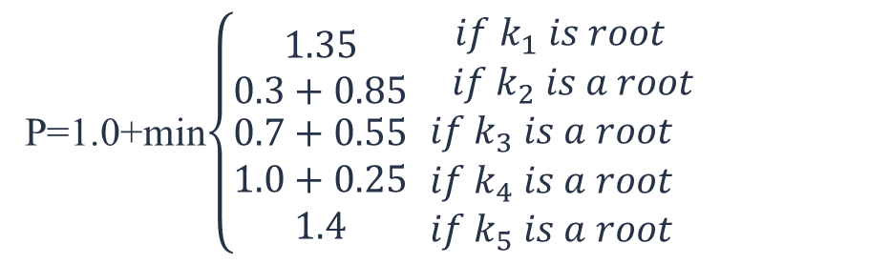

Example
Construct an optimal binary search tree over five key values k1 < k2 < k3 < k4 < k5 with access probability $0.3, 0.2, 0.1, 0.15, and 0.25,$ respectively.
 | j=1 | 2 | 3 | 4 | 5
i=1
2
3
4
5
0.3
$${0.7}^{k_{1}}$$
$${1.0}^{k_{1}}$$
$${1.4}^{k_{2}}$$
$${2.15}^{k_{2}}$$
Assume that we are having tree of length 5 then
0.2
$${0.4}^{k_{2}}$$
$${0.9}^{k_{2}}$$
$${1.35}^{k_{4}}$$
0.1
$${0.35}^{k_{4}}$$
$${0.85}^{k_{5}}$$
0.15
$${0.55}^{k_{5}}$$
0.25
P=1.0+min$\left\{\begin{matrix}1.35 \\ 0.3+0.85 \\ \begin{aligned}0.7+0.55 \\ 1.0+0.25 \\ 1.4\end{aligned}\end{matrix}\begin{matrix} if k_{1} is root \\ if k_{2} is a root \\ \begin{aligned}if k_{3} is a root \\ if k_{4} is a root \\ if k_{5} is a root\end{aligned}\end{matrix}\right.$
k1 < k2 < k3 < k4 < k5

Slide 14







Example
$$k_{2}$$
 | j=1 | 2 | 3 | 4 | 5
i=1
2
3
4
5
0.3
$${0.7}^{k_{1}}$$
$${1.0}^{k_{1}}$$
$${1.4}^{k_{2}}$$
$${2.15}^{k_{2}}$$
0.2
$${0.4}^{k_{2}}$$
$${0.9}^{k_{2}}$$
$${1.35}^{k_{4}}$$
$$k_{1}$$
$k_{3}{ k}_{4}$ $k_{5}$
$${0.35}^{k_{4}}$$
$$k_{5}$$
0.1
$${0.85}^{k_{5}}$$
0.15
$${0.55}^{k_{5}}$$
0.25
$$k_{3}{ k}_{4}$$
$$k_{4}$$
$$k_{3}$$
$$=0.3∗2+0.2∗1+4∗0.1+3∗0.15+2∗0.25=2.15$$

Slide 15







Question
Key | 10 | 12 | 16 | 21
Freq. | 4 | 2 | 6 | 3
 | j=1 | 2 | 3 | 4
i=1
2
3
4
4
$$8^{k_{1}}$$
$${20}^{k_{3}}$$
$${26}^{k_{3}}$$
2
$${10}^{k_{3}}$$
$${16}^{k_{3}}$$
6
$${12}^{k_{3}}$$
$$16$$
3
10
21
12

Slide 16






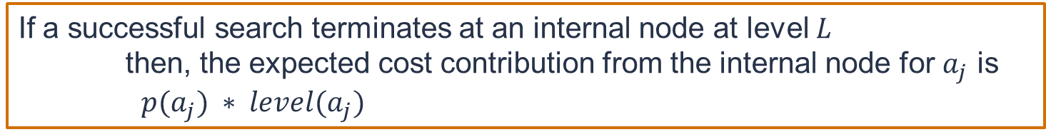
Search Case
The case of search are two situations, one is success, and the other, without saying, is failure.
If a successful search terminates at an internal node at level $L$
then, the expected cost contribution from the internal node for $a_{j}$ is
$p(a_{j}) ∗ level(a_{j})$
Unsuccessful searches terminate at external nodes
the cost contribution of the external node is $q(i) ∗ (level\left(Ei\right)−1)$
$$E_{0}$$
$$E_{1}$$
T′
$$E_{2}$$
$$E_{4}$$
$$E_{5}$$
$$E_{6}$$

Slide 17
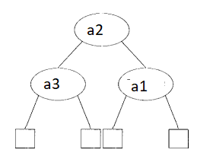
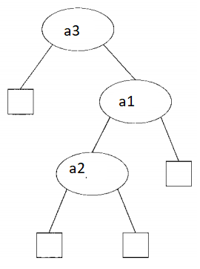
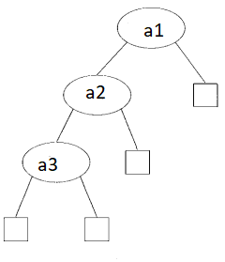

Example
The possible binary search trees for the keys ($a_{1},a_{2},a_{3}$) are given with following probabilities:
With p(l)= .5, p(2) = .1, p(3) = .05,
q(0)= .15, q(l) = .1, q(2)= .05 and q(3)= .05
(a) $\{ 1×0.5+2×0.1+3×.05 \}+\{ 3×0.15+3×0.1+2×.05+1×.05 \}=1.75$
(b) 1.9
(c) 2.05

Slide 18
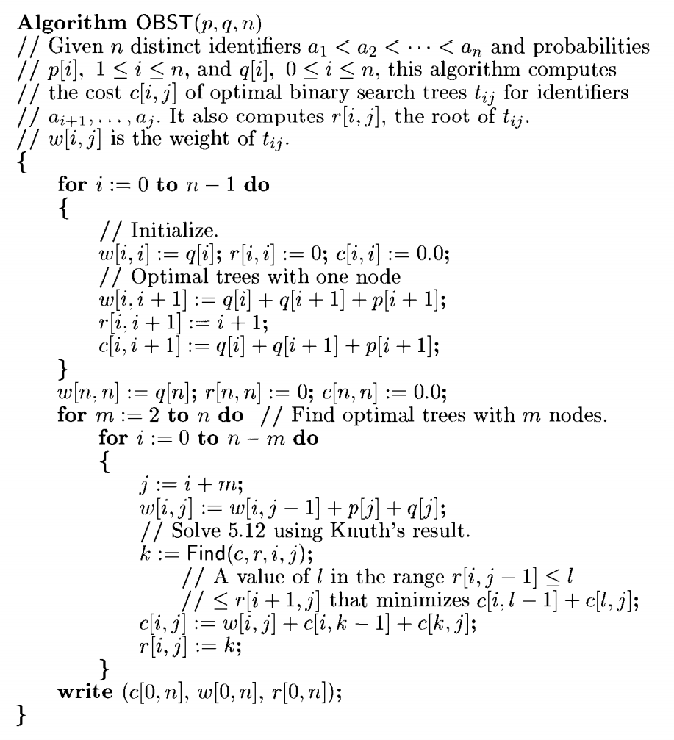
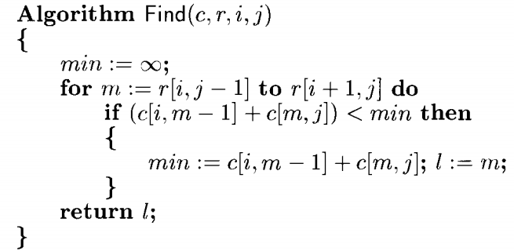
Question

Slide 19
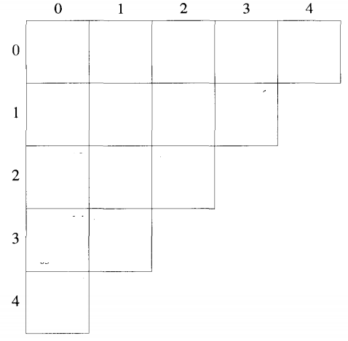




















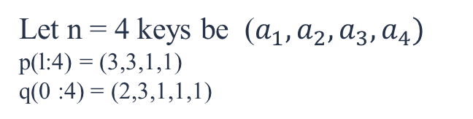


Question
Let n = 4 keys be ($a_{1}, a_{2},a_{3}, a_{4})$
p(l:4) = (3,3,1,1)
q(0 :4) = (2,3,1,1,1)
$$w_{02}=8+3+1=12$$
$$if m=1$$
$$m=1 to 2$$
$$min=c_{00}+c_{12}=7 l=1$$
$$if m=2$$
$c_{01}+c_{22}=$8$>min$,
$$c_{02}=12+0+7=19$$

Slide 20
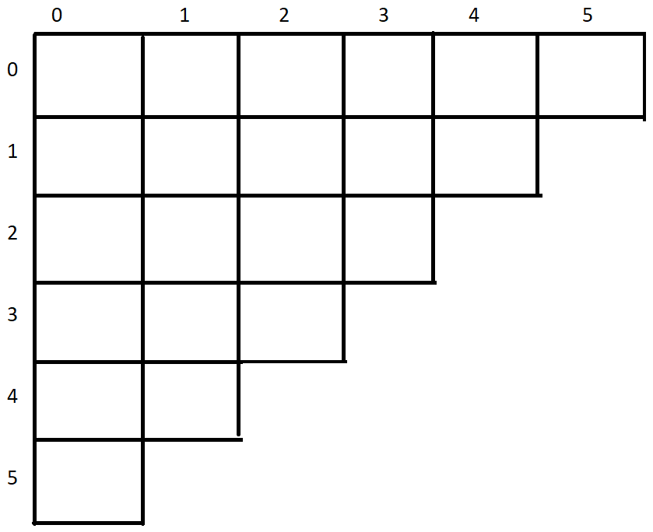
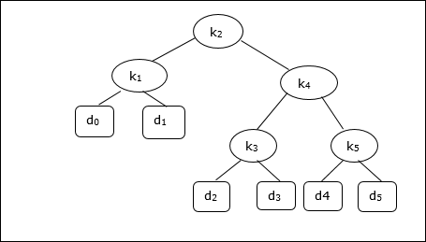
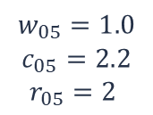



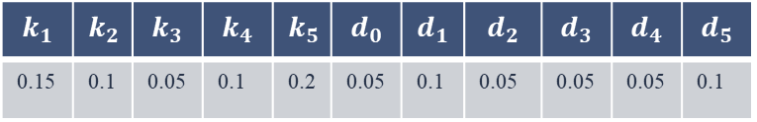

















Question
Given a binary search tree, check whether it is optimal binary search tree or not.
Search cost of the nodes are as follows
$$w_{oo}=.05$$
$$c_{00}=0$$
$$r_{00}=0$$
$$w_{11}=.1$$
$$c_{11}=0$$
$$r_{11}=0$$
$$w_{22}=.05$$
$$c_{22}=0$$
$$r_{22}=0$$
$$w_{33}=.05$$
$$c_{33}=0$$
$$r_{33}=0$$
$$w_{44}=.05$$
$$c_{44}=0$$
$$r_{44}=0$$
$$w_{55}=.1$$
$$c_{55}=0$$
$$r_{55}=0$$
$$w_{o1}=0.3$$
$$c_{01}=0.3$$
$$r_{01}=1$$
$$w_{12}=.25$$
$$c_{12}=.25$$
$$r_{12}=2$$
$$w_{23}=.15$$
$$c_{23}=0.15$$
$$r_{23}=3$$
$$w_{34}=.2$$
$$c_{34}=0.2$$
$$r_{34}=4$$
$$w_{45}=.35$$
$$c_{45}=.35$$
$$r_{45}=5$$
$$w_{o2}=0.45$$
$$c_{02}=0.7$$
$$r_{02}=1$$
$$w_{13}=.35$$
$$c_{13}=.5$$
$$r_{13}=2$$
$$w_{24}=.30$$
$$c_{24}=.45$$
$$r_{24}=4$$
$$w_{35}=.5$$
$$c_{35}=.7$$
$$r_{35}=5$$
$$w_{03}=.55$$
$$c_{03}=1.0$$
$$r_{03}=2$$
$$w_{14}=.50$$
$$c_{14}=.95$$
$$r_{14}=2$$
$$w_{25}=.60$$
$$c_{25}=.9$$
$$r_{25}=5$$
$$w_{04}=.7$$
$$c_{04}=1.45$$
$$r_{04}=2$$
$$w_{15}=.8$$
$$c_{15}=1.65$$
$$r_{15}=4$$
$$w_{05}=1.0$$
$$c_{05}=2.2$$
$$r_{05}=2$$
$$k_{1}$$ | $$k_{2}$$ | $$k_{3}$$ | $$k_{4}$$ | $$k_{5}$$ | $$d_{0}$$ | $$d_{1}$$ | $$d_{2}$$ | $$d_{3}$$ | $$d_{4}$$ | $$d_{5}$$
0.15 | 0.1 | 0.05 | 0.1 | 0.2 | 0.05 | 0.1 | 0.05 | 0.05 | 0.05 | 0.1

Slide 21
Analysis
The algorithm requires O(n2 ) time and O(n2 ) storage.
Therefore, as ‘n’ increases it will run out of storage even before it runs out of time.
The storage needed can be reduced by almost half by implementing the two-dimensional arrays as one dimensional arrays.

Slide 22



